Slide 1
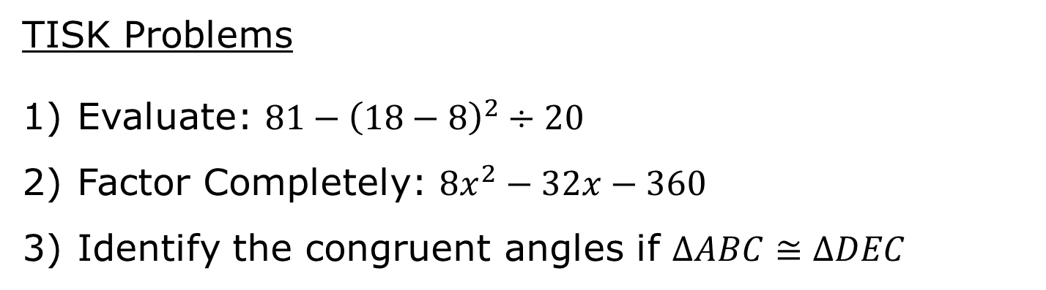
Thursday, November 1, 2012
Homework: 5-2 worksheet
TISK Problems
Evaluate: $81−{\left(18−8\right)}^{2}÷20$
Factor Completely: $8x^{2}−32x−360$
Identify the congruent angles if $ΔABC≅ΔDEC$
B
E
A
C
D

Slide 2
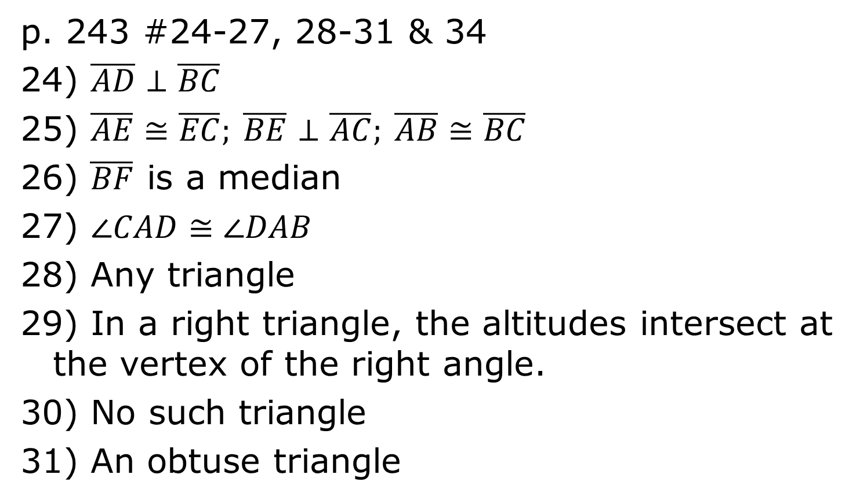
Homework Check
p. 243 #24-27, 28-31 & 34
24) $\overline{AD}⊥\overline{BC}$
25) $\overline{AE}≅\overline{EC}; \overline{BE}⊥\overline{AC}; \overline{AB}≅\overline{BC}$
26) $\overline{BF}$ is a median
27) $∠CAD≅∠DAB$
28) Any triangle
29) In a right triangle, the altitudes intersect at the vertex of the right angle.
30) No such triangle
31) An obtuse triangle

Slide 3
Homework Check
34) If an angle bisector of an angle is also an altitude, then the triangle is isosceles.

Slide 4
Chapter 5…?
We will be using a supplemental text for Chapter 5.
Each night, supplemental “notes” will be provided on my website.
Homework Calendar -> Handouts
In this text, an important theorem was covered in the previous chapter that we will add to our notes now!

Slide 5
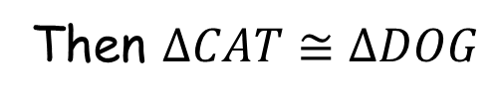
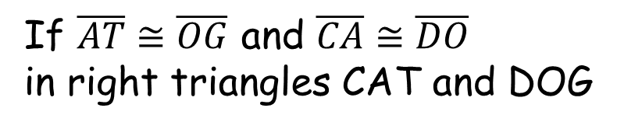
Theorem
The ONE time that SSA works, and we call it something else…
Hypotenuse-Leg (HL) Theorem
If the hypotenuse and leg of a right triangle are congruent to the hypotenuse and leg of a second right triangle, then the two triangles are congruent.
D
A
G
O
If $\overline{AT}≅\overline{OG}$ and $\overline{CA}≅\overline{DO}$ in right triangles CAT and DOG
C
T
Then $ΔCAT≅ΔDOG$

Slide 6
§5.2 Bisectors of a Triangle
Lines that intersect in the same point are concurrent lines
The point they intersect at is called the point of concurrency
Point of concurrency
d
c
b, c, and d are concurrent
a
b
a, b, & c are not

Slide 7
Circumcenter
The circumcenter is the point of concurrency of the perpendicular bisectors of a triangle.
circumcenter

Slide 8
Concurrency of Perpendicular Bisectors of a Triangle Theorem
The circumcenter is equidistant from the vertices of the triangle.
FC = CI = CT
F
C
I
T

Slide 9
Angle Bisector of a Triangle
The bisector of an angle of a triangle is called the angle bisector of the triangle.
Incenter
The incenter is the point of concurrency of the angle bisectors.
Angle Bisector of the triangle

Slide 10
Concurrency of Angle Bisectors of a Triangle Theorem
The incenter is equidistant from the sides of the triangle.
AI = BI = CI
C
I
B
A

Slide 11
The Angle Bisectors of Triangle XYZ meet at point P.
Which segments are congruent?
Find PT and PV.
T
12
X
Y
P
13
U
V
Z

